Slide 1

Chapter 4

Slide 2

Cascade of 4 Full Adders, or a 4-bit adder
x₀
y₀
x₀
y₀
x₀
y₀
x₀
y₀
FA
FA
FA
c₁
FA
c₀
c₄
c₃
c₂
s₃
s₂
s₁
s₀
s₀ available after 1 gate delays, c₁ available after 2 gate delays.
s₁ available after 3 gate delays, c₂ available after 4 gate delays.
s₂ available after 5 gate delays, c₃ available after 6 gate delays.
s₃ available after 7 gate delays, c₄ available after 8 gate delays.
For an n-bit adder, s_{n-1} is available after 2n-1 gate delays
c_{n} is available after 2n gate delays.

Slide 3
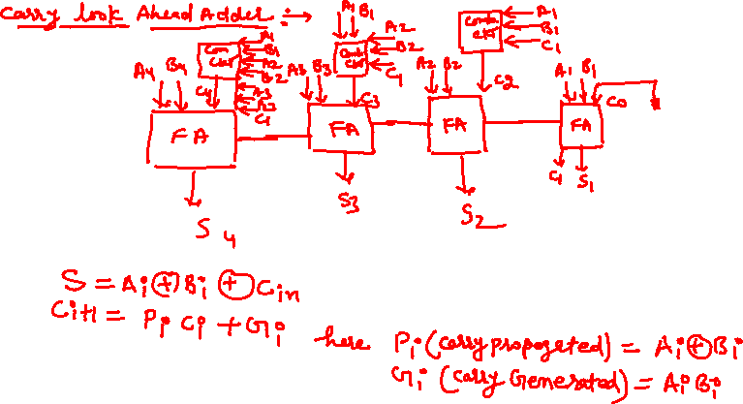

Slide 4


Slide 5
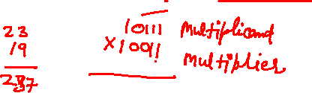


Slide 6
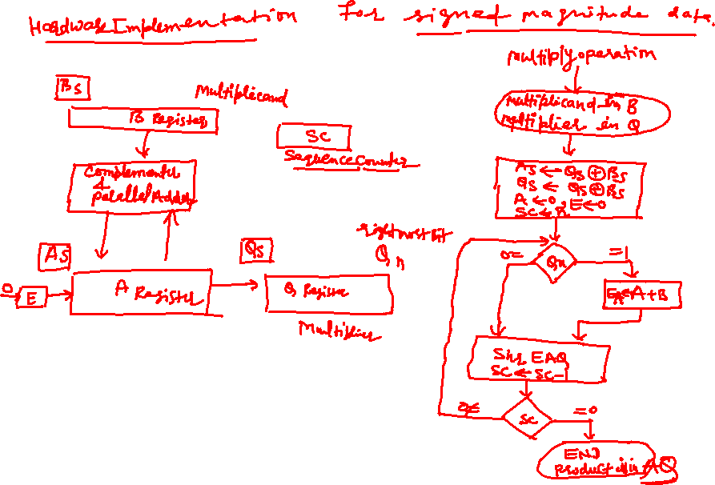

Slide 7
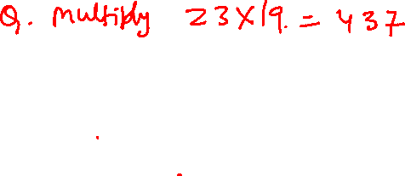
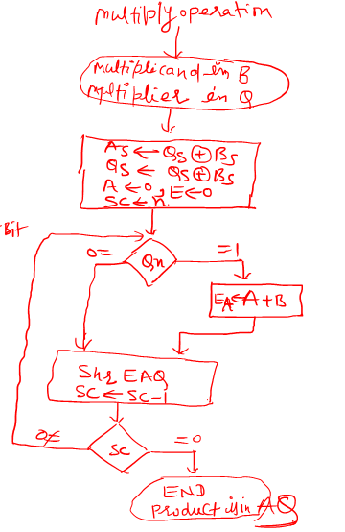
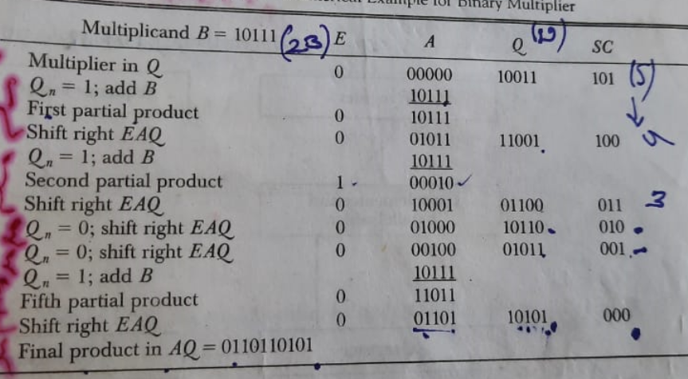

Slide 8
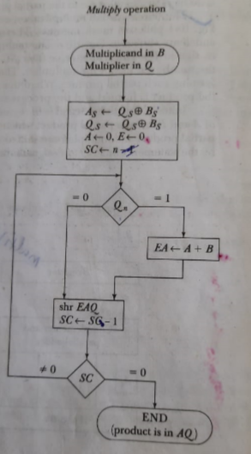

Slide 9
Booths Algorithm

Slide 10
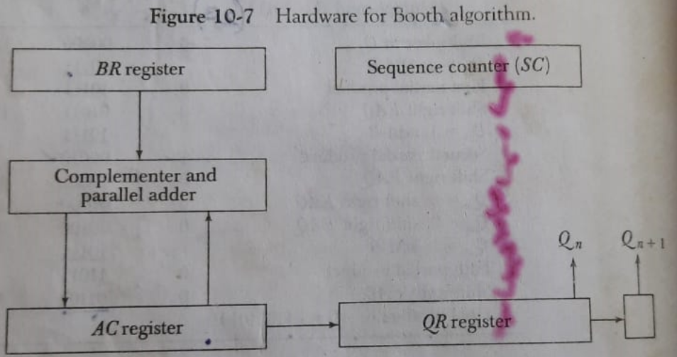

Slide 11
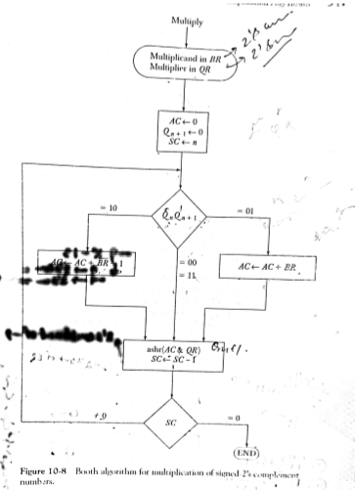

Slide 12

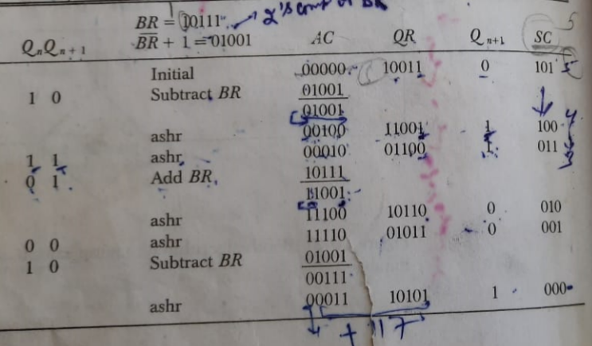

Slide 13


Slide 14
Manual Division
13
21
1101
10101
274
100010010
26
1101
14
10000
13
1101
1
1110
1101
1
Longhand division examples.

Slide 15
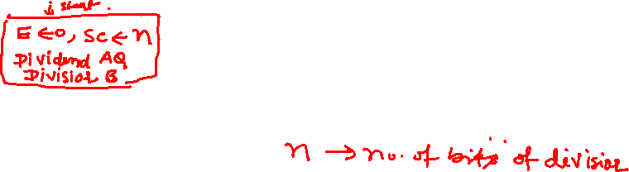
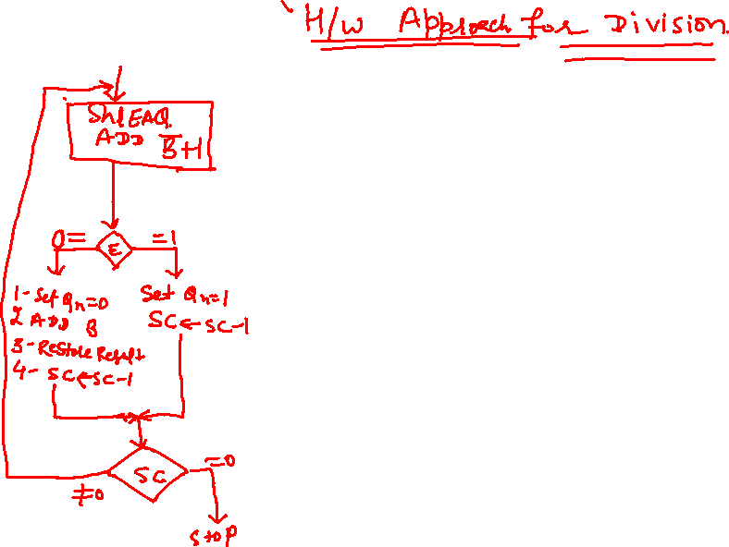

Slide 16
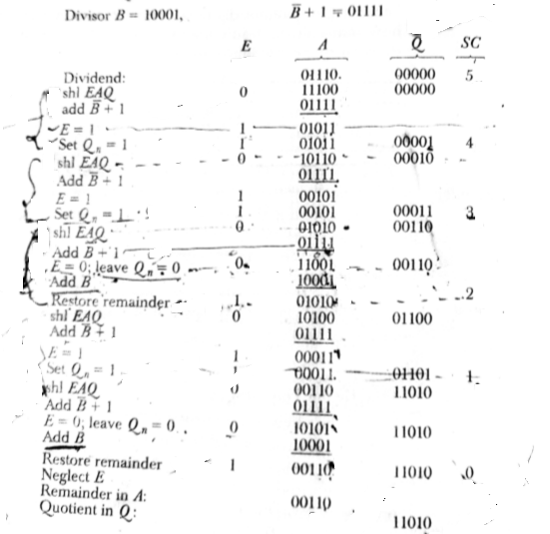

Slide 17

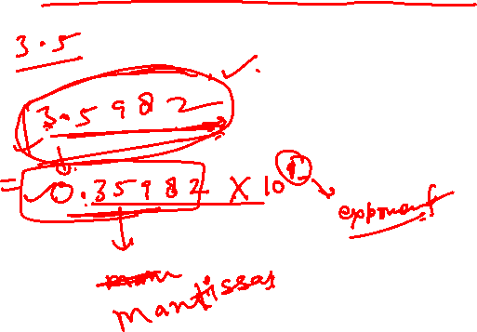

Slide 18

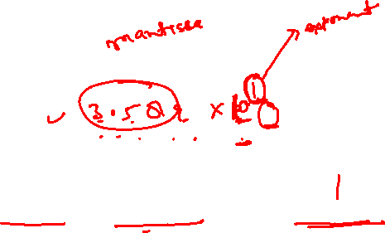

Previous representations have a fixed point. Either the point is to the immediate right or it is to the immediate left. This is called Fixed point representation.
Fixed point representation suffers from a drawback that the representation can only represent a finite range (and quite small) range of numbers.
A more convenient representation is the scientific representation, where
the numbers are represented in the form:
Components of these numbers are:
Mantissa (m), implied base (b), and exponent (e)

Slide 19

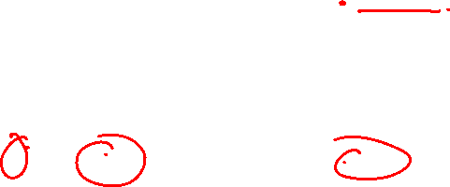
1 7 24
Sign Exponent Fractional mantissa
bit

Slide 20

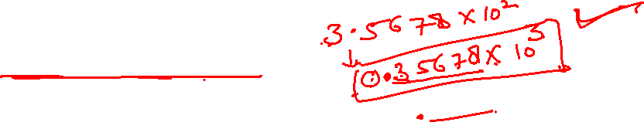
Consider the number:
x = 0.0004056781 x 10¹²
If the number is to be represented using only 7 significant mantissa digits,
the representation ignoring rounding is:
x = 0.0004056 x 10¹²
If the number is shifted so that as many significant digits are brought into
7 available slots:
x = 0.4056781 x 10⁹ = 0.0004056 x 10¹²
Exponent of x was decreased by 1 for every left shift of x.
A number which is brought into a form so that all of the available mantissa
digits are optimally used (this is different from all occupied which may
not hold), is called a normalized number.
Same methodology holds in the case of binary mantissas
0001101000(10110) x 2⁸ = 1101000101(10) x 2⁵

Slide 21
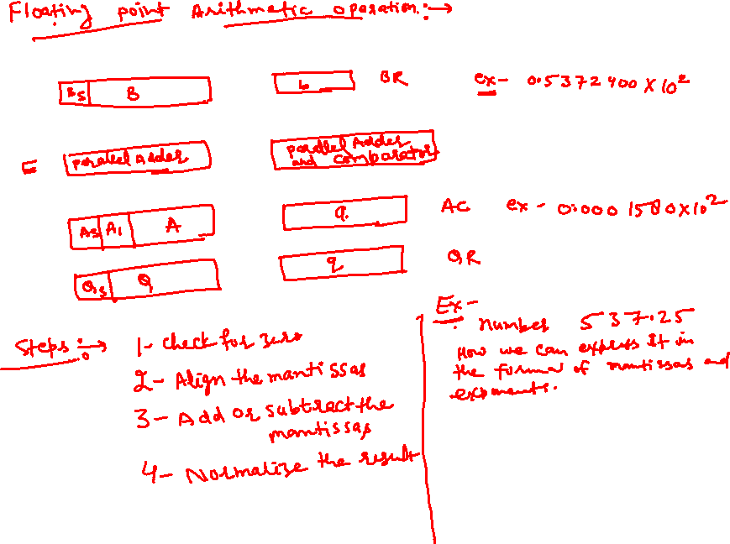

Slide 22
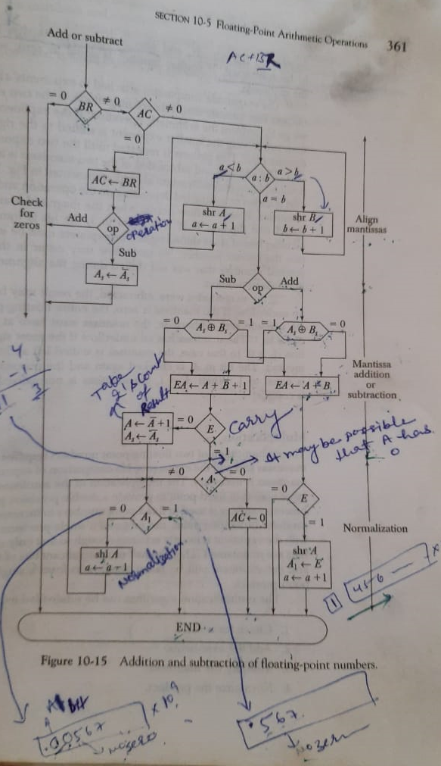
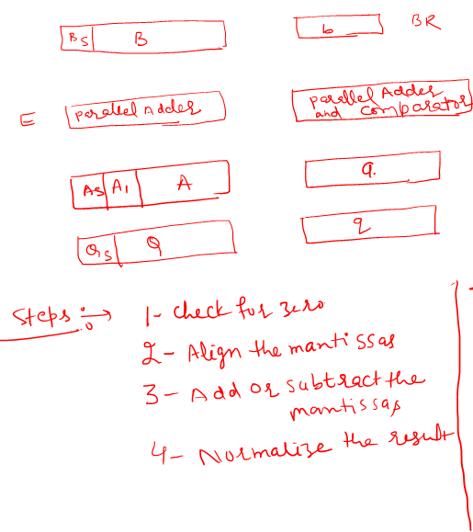

Slide 23


